Slide 1
Unlocking the Classroom through OER
David Wiley, PhD
Lumen Learning / Creative Commons / BYU
@opencontent

Slide 2
Unless otherwise noted this presentation is licensed CC BY 4.0

Slide 3
A Word About Lumen
Founded in 2012; 30 people
Focus on at-risk students and their faculty
Services and tools to make OER adoption (1) simple and (2) effective
CC BY license all content we create
Saved 110k+ students $10M in 2016
Will save 160k+ students $15M in 2017

Slide 4
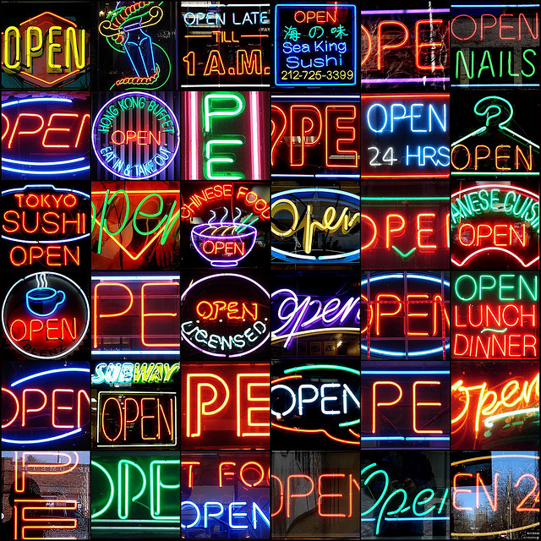
Which “open”?
Notes:
CC BY NC SA photo from https://www.flickr.com/photos/mag3737/1914076277

Slide 5
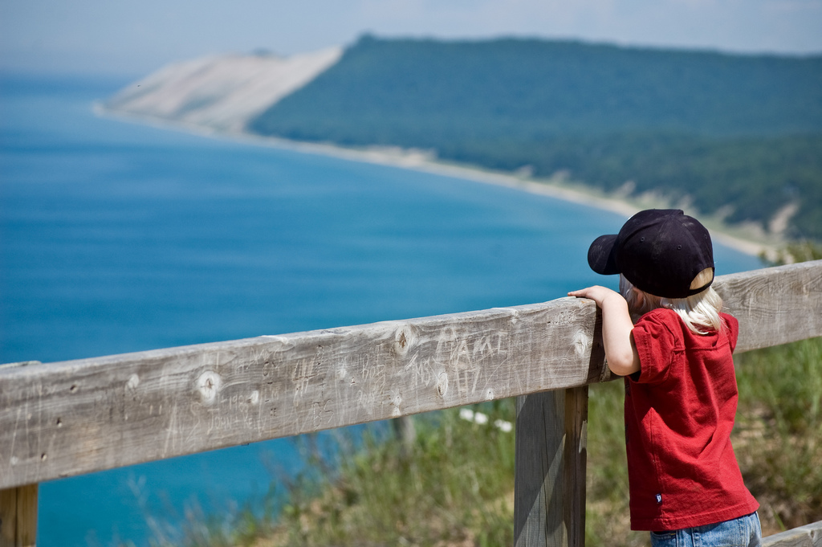
Open Educational Resources (OER)
Notes:
CC BY image from https://www.flickr.com/photos/kretyen/2628104710

Slide 6
open ≈ free

Slide 7
the internet is already free to read / watch / listen to

Slide 8
open = free + permissions

Slide 9
The 5R Activities
Reuse
Use in a wide range of ways
Revise
Adapt, modify, and improve
Remix
Share with others
Combine two or more
Redistribute
Retain
Make and own a copy

Slide 11
The 5R Activities
Reuse
Use in a wide range of ways
Revise
Adapt, modify, and improve
Remix
Share with others
Combine two or more
Redistribute
Retain
Make and own a copy

Slide 12
Open
Free plus permission to engage in the 5R activities

Slide 13
“Faux-pen”
1. Free (but gated) access
2. All Rights Reserved plus draconian Terms of Use

Slide 14
 | Cost to Students | Permissions for Faculty and Students
Commercial Textbooks | Expensive | Restrictive
“The Web” MOOCs Library Resources | “Free” | Restrictive
Open Educational Resources | Free | 5Rs

Slide 15
OER Examples
Full courses, complete textbooks, chapters, modules, videos, simulations, assessments, syllabi, etc.

Slide 16
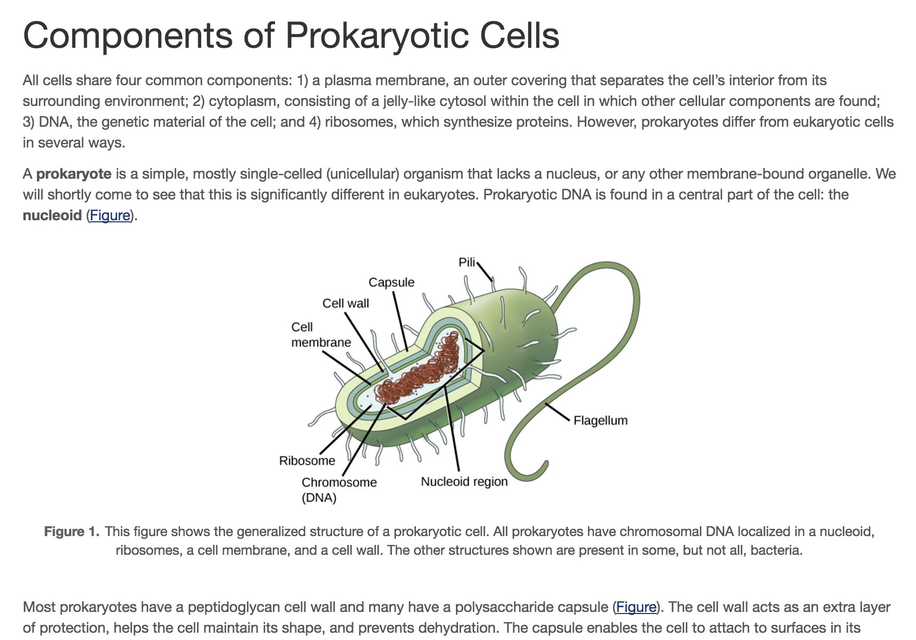

Slide 17
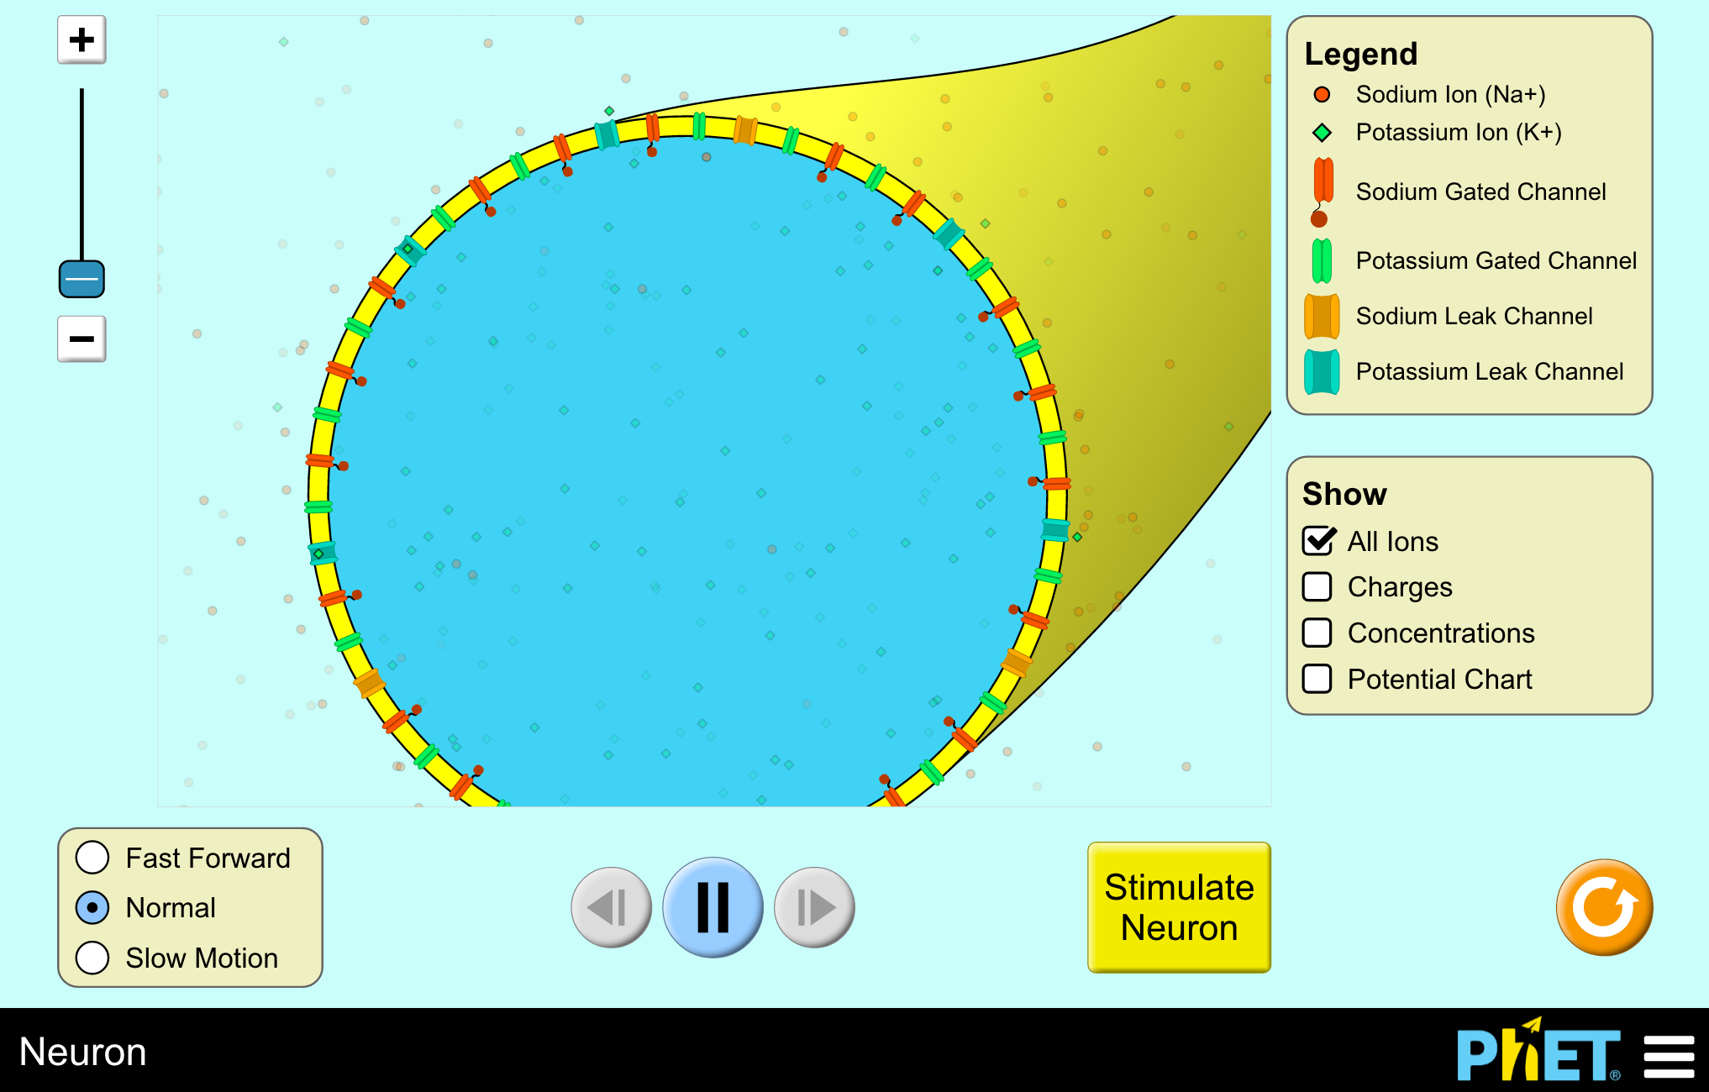

Slide 18
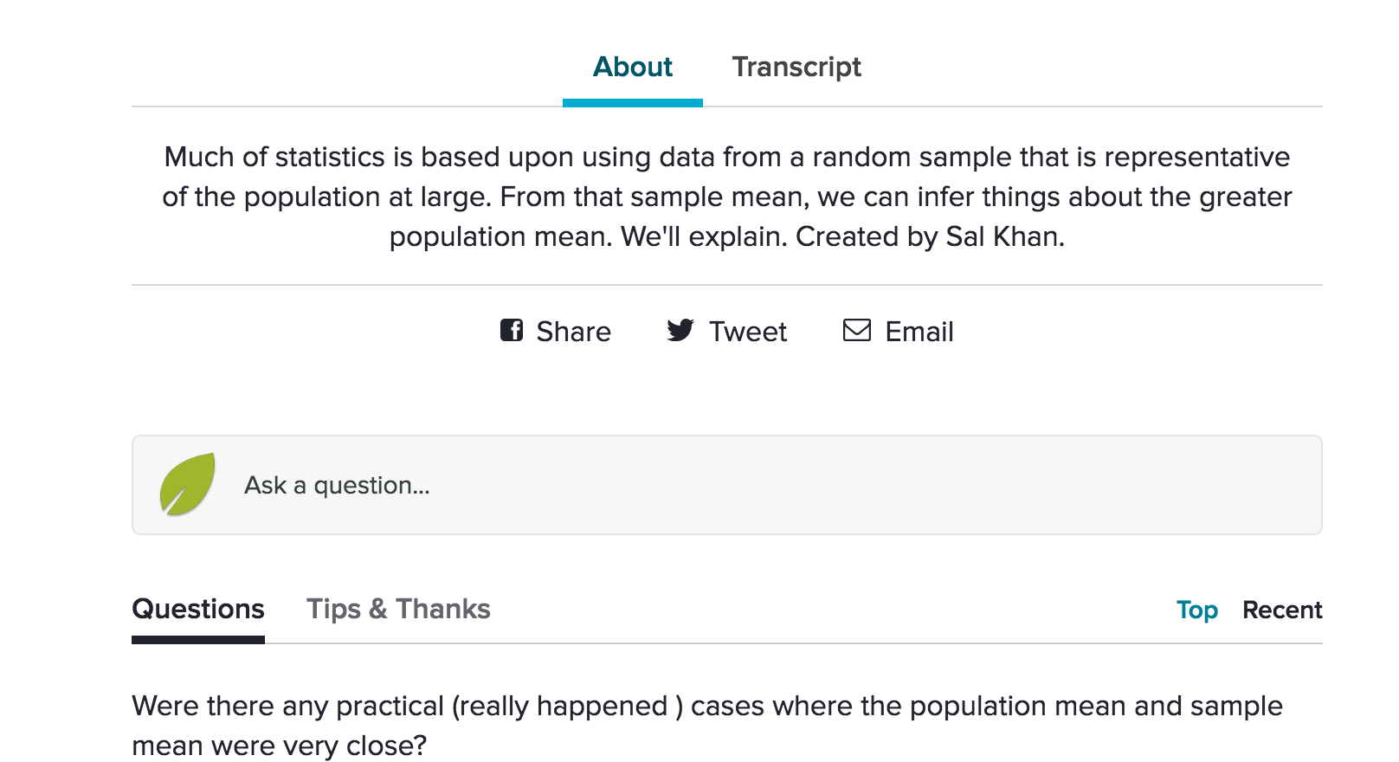

Slide 20
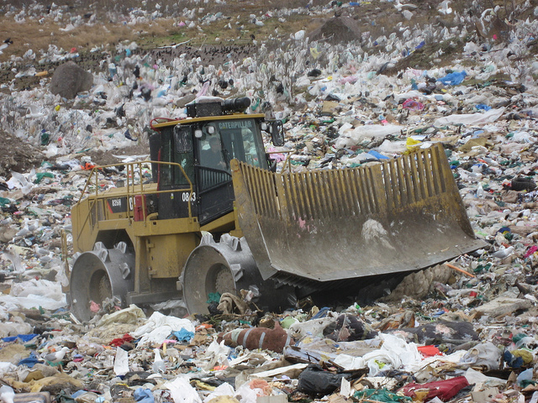
US college students spend approximately 40 million hours doing homework every year
Notes:
Photo from https://flic.kr/p/8TzAA6, CC BY, Colin Delaney

Slide 21
Reclaiming and Sustaining
Our current model of producing OER is unsustainable (e.g., $500k - $1M / textbook).
In the US alone, undergraduates spend about 40M hours per year on homework that is mostly thrown away.
Can students sustainably create OER?
Can those OER support learning both by them and other students?

Slide 22
Engage Students Differently
Change the way we teach and assess

Slide 23
How Might Open Influence Pedagogy?
We learn by the things we do.
Copyright restricts what we are permitted to do.
Consequently, copyright restricts the ways we are permitted to learn.
Open removes these restrictions, permitting us to do new things.
Consequently, open permits us to learn in new ways.

Slide 24
Context Specific
What do the 5R activities enable in the context of your preferred pedagogy?

Slide 25
Constructionist Pedagogy
We learn best when we’re “actively engaged in constructing something that has personal meaning to [us] - be it a poem, a robot, a sandcastle, or a computer program.”
- Seymour Papert

Slide 26
Constructionist Pedagogy
Learning “happens especially felicitously in a context where the learner is consciously engaged in constructing a public entity.”
- Seymour Papert

Slide 27
 | Student creates an artifact | Artifact has personal meaning for student | Artifact is shared publicly | Artifact is shared under an open license
Disposable | X
Authentic | X | X
Constructionist | X | X | X
Renewable | X | X | X | X

Slide 28
From Consumers to Creators
Change how students engage with knowledge

Slide 29
From Creators to Enablers
Creating opportunities to extend and build upon what they create

Slide 30
Examples

Slide 31
Medical School Students
UCSF Expanding WikiProject Medicine - https://en.wikipedia.org/wiki/Wikipedia:WikiProject_Medicine/UCSF_Elective_2013

Slide 32
Graduate Students

Slide 33
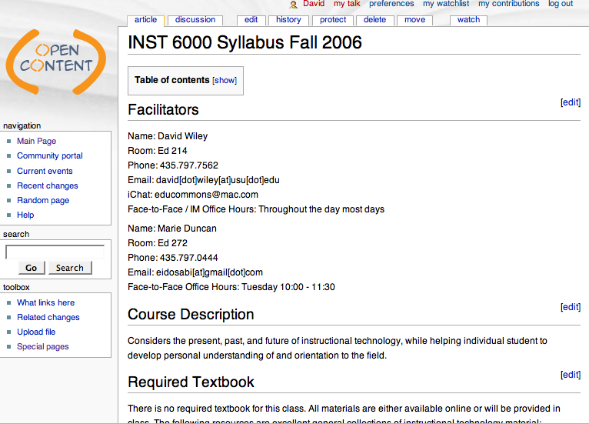

Slide 34
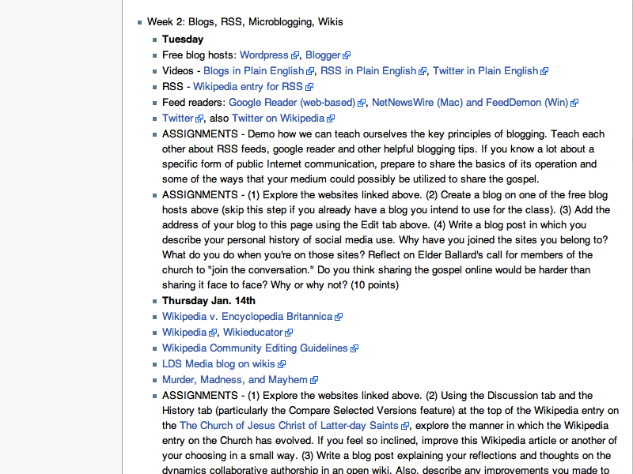

Slide 36
Graduate Students
PM4ID - https://pm4id.org/
Open Ed Reader- https://openedreader.org/
District Policies Regarding Blogs and Wikis - https://www.youtube.com/watch?v=4_Lk2uU_elU
Blogs vs Wikis - https://www.youtube.com/watch?v=AsFU3sAlPx4

Slide 37
Undergraduate Students
Murder, Madness, Mayhem: Latin American Literature in Translation - https://en.wikipedia.org/wiki/Wikipedia:WikiProject_Murder_Madness_and_Mayhem
Open Anthology of Early American Literature - https://openamlit.pressbooks.com/

Slide 38
Middle and High School Students

Slide 39
A Preliminary Exploration of the Relationships Between Student-Created OER, Sustainability, and Student Success at the Secondary Level
David Wiley, DeLaina Tonks, Sarah Weston, and Ashley Webb
IRRODL, forthcoming

Slide 40
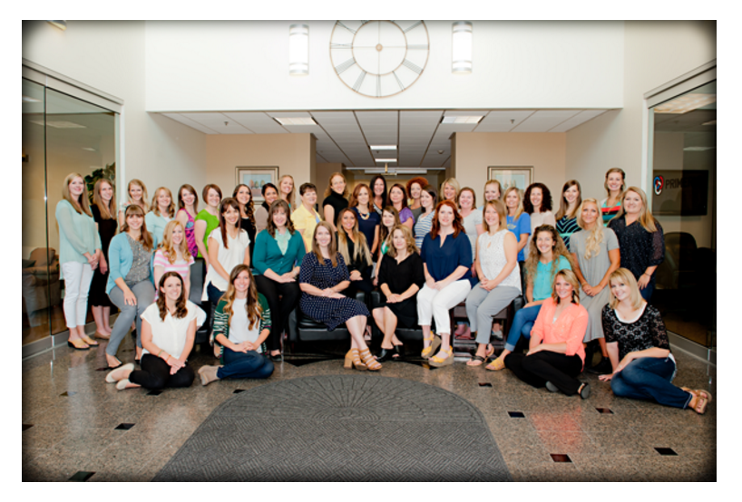
Notes:
CC BY, Mountain Heights Academy

Slide 41
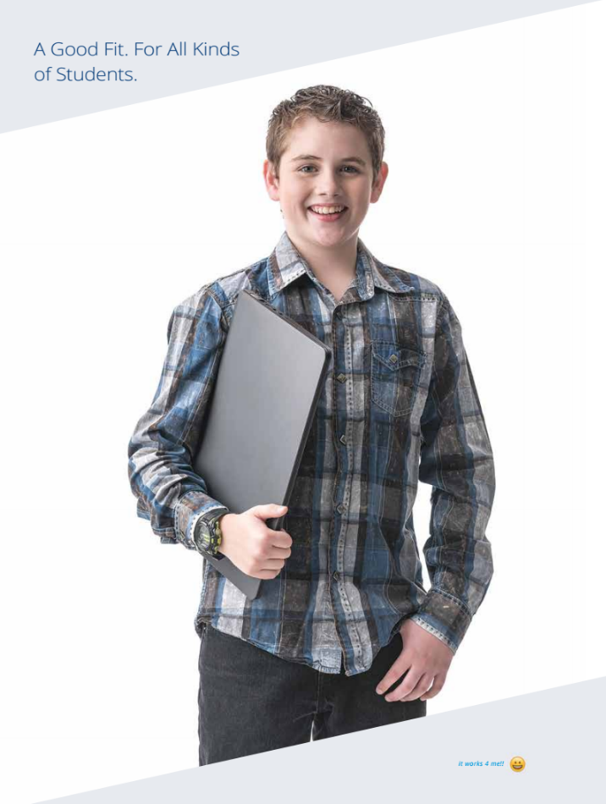
Online, public charter school
Opened in 2009 as Open High School of Utah
7-12 grades
575 full-time students
200 part-time students
CC-BY MountainHeightsAcademy
Notes:
CC BY, Mountain Heights Academy

Slide 42
Research Context
Course on Digital Photography
Data covering 181 middle and high school students over 4 years
Teacher, course assignments, and grading rubrics remained stable over the four years
IRRODL (in press)

Slide 43
Methodology
Post-hoc design
Students were invited to create / remix open tutorials, study guides, and games
Extra credit or TA credit
From no student-created OER to 10% of the course over four years
Compare student grades on course assignments
IRRODL (in press)

Slide 44
Notes:
CC-BY MountainHeightsAcademy

Slide 45
Notes:
CC-BY MountainHeightsAcademy

Slide 46
Notes:
CC-BY MountainHeightsAcademy

Slide 47
Notes:
CC-BY MountainHeightsAcademy

Slide 48
Notes:
CC-BY MountainHeightsAcademy

Slide 49
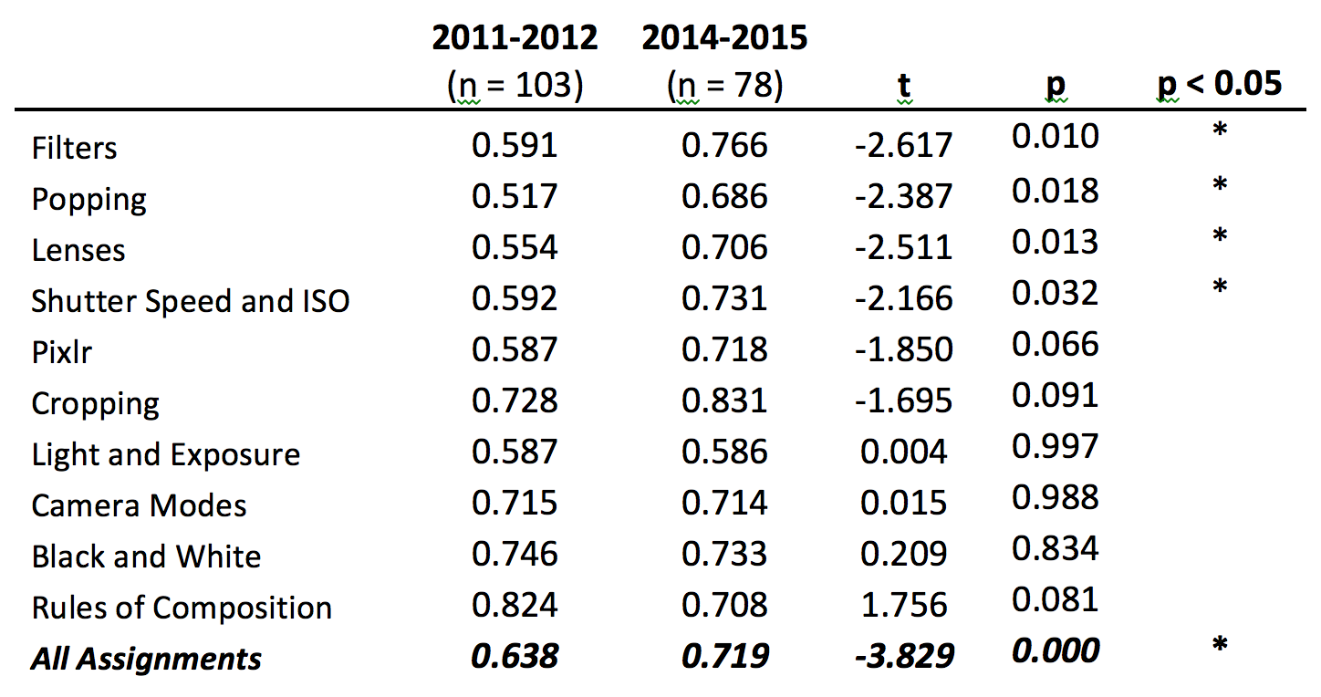
IRRODL (in press)

Slide 50
Practical Considerations, 1
Talking to students about open licensing
Providing alternatives
Talking to students about digital identity
Merging student OER into the "official" course OER

Slide 51
Practical Considerations, 2
Keeping your course OER outside the LMS
Managing attribution
Time, time, time
Prioritizing contributions - http://lumenlearning.com/how/learning-lab/oer2/

Slide 52
Pedagogical Curiosity
What are the set of teaching and learning practices only possible or practical when you have permission to engage in the 5R activities?
How will they transform both us and our students?

Slide 53
Conversation! @opencontent david@lumenlearning.com

